Slide 1







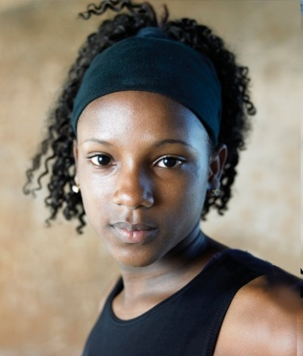
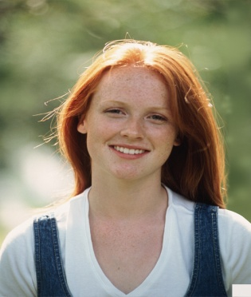
KEY CONCEPT Human inheritance patterns are more complex.

Slide 2
Human Inheritance Patterns
We will study 7 common inheritance patterns in humans:
Autosomal dominant traits
Autosomal recessive traits
Autosomal codominant traits
Polygenic traits
Multiple allele traits
Sex-linked traits
Chromosomal abnormalities

Slide 3
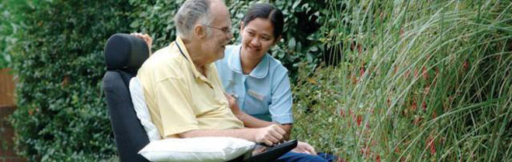
(1) Autosomal dominant
The DNA code causing the trait is dominant
Example: Huntington’s
HH = has Huntington’s
Hh = has Huntington’s
hh = does NOT have Huntington’s

Slide 4
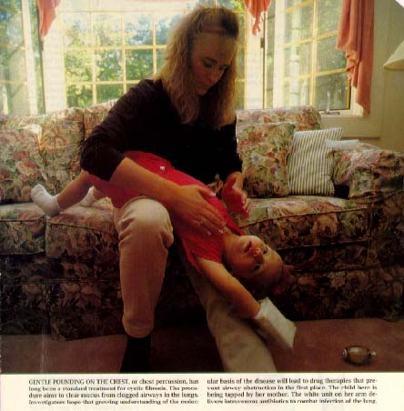
(2) Autosomal recessive
The DNA code causing the trait is recessive
Example: Cystic fibrosis
ff = has cystic fibrosis
FF = does NOT have cystic fibrosis
Ff = does NOT have cystic fibrosis but is a carrier

Slide 5
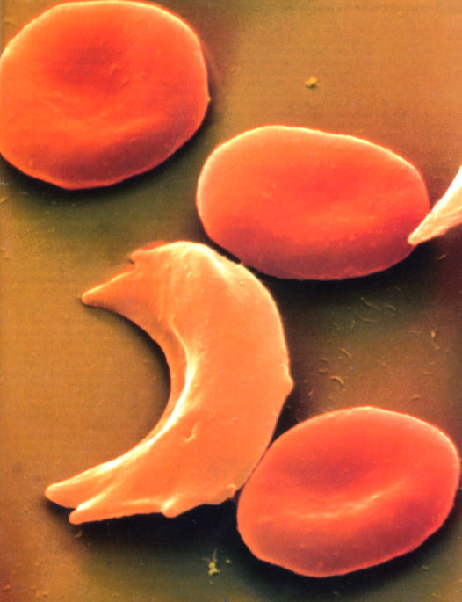
(3) Autosomal codominant
The allele causing the trait is codominant
Example: sickle cell anemia
A = normal cells
A’ = sickle cells
A A = all normal cells
A’A’ = all sickle cells
A A’ = some of each

Slide 6
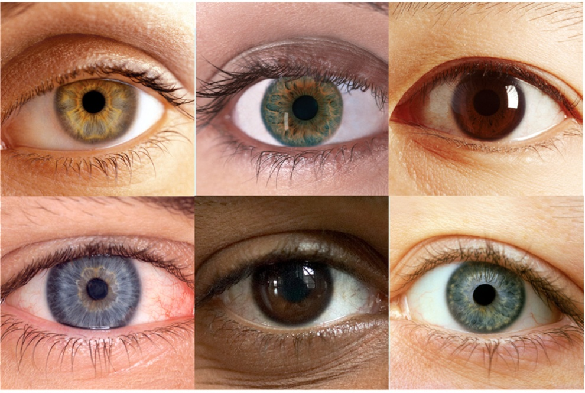
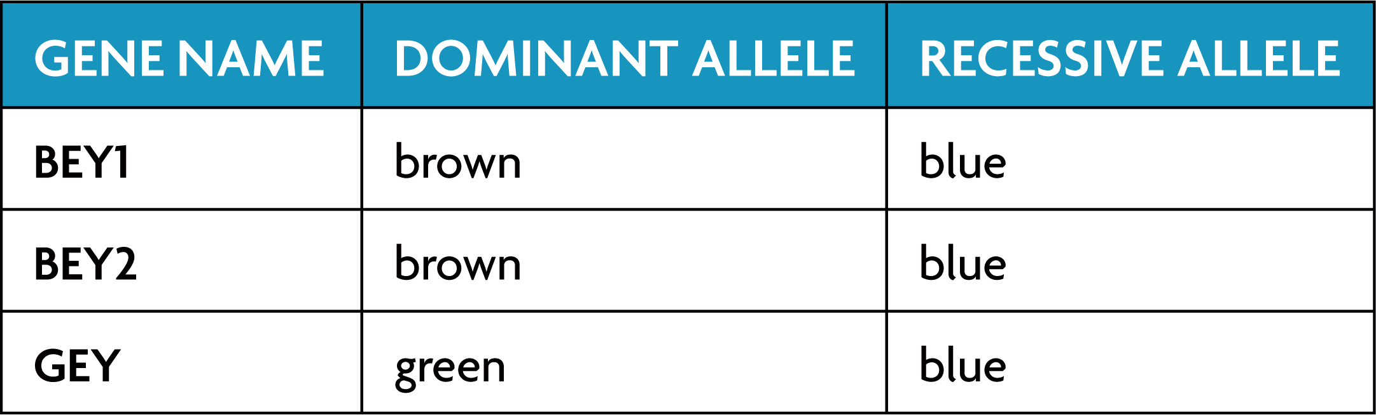
(4) Polygenic Traits
Many genes interact to produce one trait.
Examples: skin, eye, & hair color
Order of dominance: brown > green > blue.

Slide 7
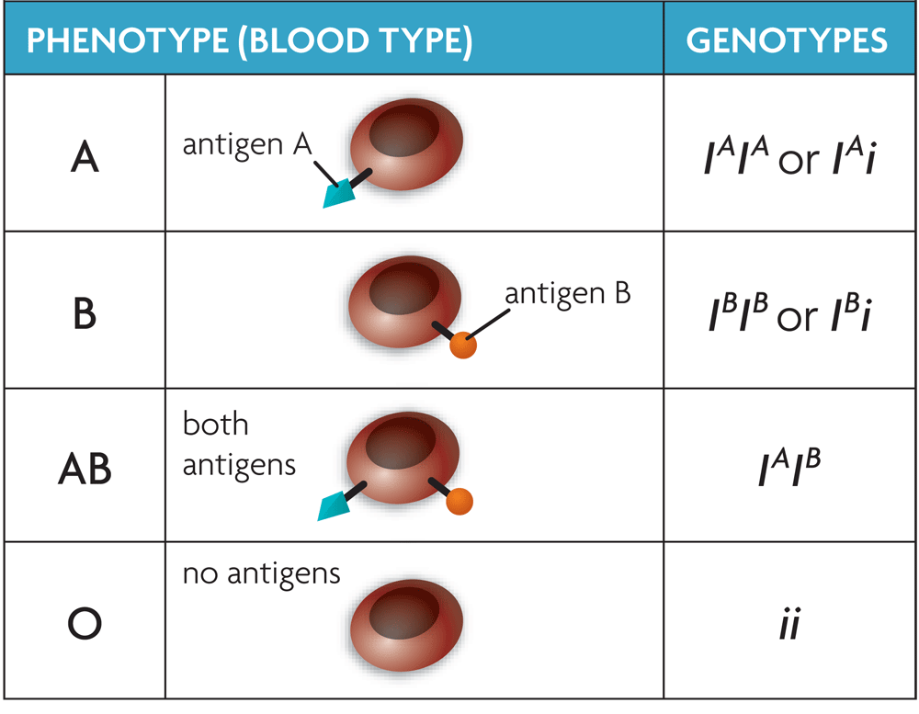
(5) Multiple Allele Traits
Traits determined by one gene with 3 or more choices of DNA codes
Example:
Blood type (I^{A} , I^{B}, iº)

Slide 8
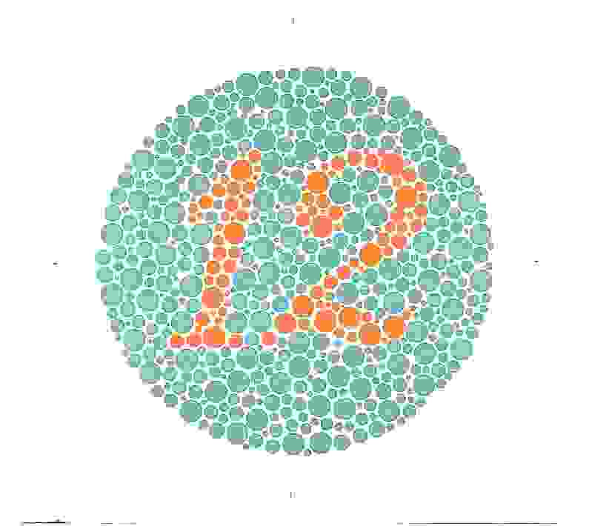
(6) Sex-Linked Traits
Alleles are carried on the X chromosome
Example: Red-green colorblindness
B = normal b = colorblind
Males Females
XY XX
XY XX
XX

Slide 9
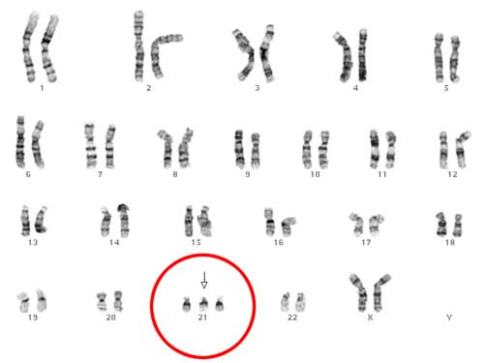
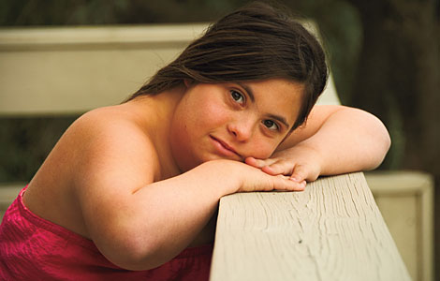
(7) Chromosomal abnormalities, Trisomy 21, Down Syndrome
(a) Extra or missing chromosomes cause disorders.
Monosomy: only 1 of 2 chromosomes present
Trisomy: 3 chromosomes present (instead of 2)

Slide 10

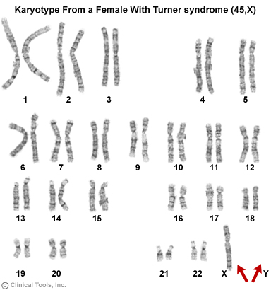
(Chromosomal abnormalities continued) Turner’s Syndrome, one X chromosome

Slide 11

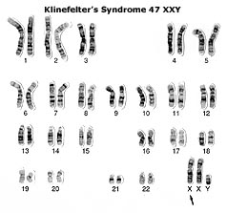
(Chromosomal abnormalities continued)

Slide 12

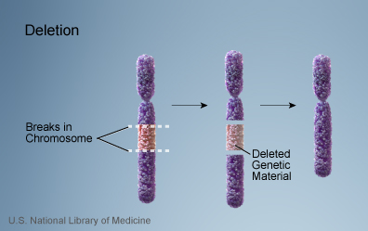
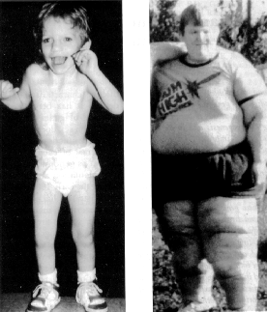
Other Chromosomal abnormalities, Cri du Chat, small deletion of chromosome #5
Missing parts of a chromosome
Deletion, Inversion, Translocation
Many survive to adulthood with marked disability

Slide 13
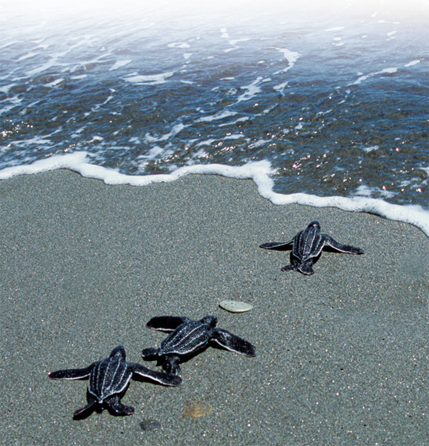
The environment interacts with genes, too.
Phenotype is a combination of genotype and environment.
The sex of sea turtles depends on both genes and the temperature around the egg
Height is strongly affected by the environment.

